Slide 1
Introductory Project Computer Architecture FIM-UHK
José Luis Pedraza Román

Slide 2
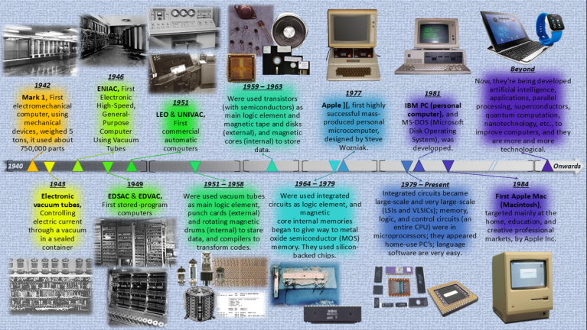
History of Computers
A brief timeline:
https://www.livescience.com/20718-computer-history.html
A interesting timeline video:
https://www.youtube.com/watch?v=-M6lANfzFsM

Slide 3
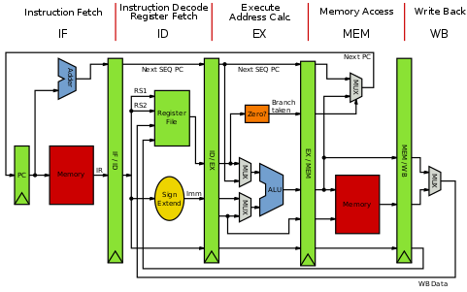
How a computer works
https://byte-notes.com/five-basic-components-computer-system/
The major hardware components of a computer system are:
Processor
Main Memory
Secondary Memory
Output devices
Input devices

Slide 4
Von Neumann and Harvard architectures
http://www.differencebetween.net/technology/difference-between-von-neumann-and-harvard-architecture/
The Von Neumann bottleneck has increased over time because processors have improved in speed while memory has not progressed as fast.
To reduce “bottleneck”:
to keep memory in cache to minimize data movement
hardware acceleration
speculative execution
It’s interesting to note that speculative execution is the conduit for one of the latest security flaws discovered by Google Project Zero, named Spectre.

Slide 5
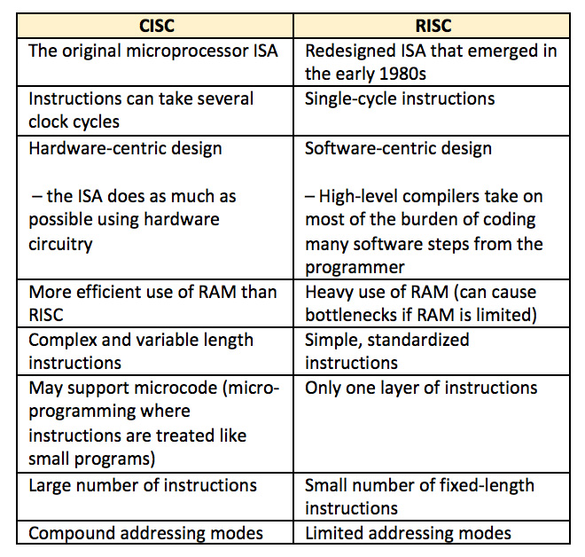
RISC and CISC architectures
https://www.edgefxkits.com/blog/what-is-risc-and-cisc-architecture/
https://www.youtube.com/watch?v=mDrUkjOVtAU
https://www.youtube.com/watch?v=07cpxBfy7JI

Slide 6
Computer memory
Link: chapter 5
https://oliva.uhk.cz/bbcswebdav/pid-127494-dt-content-rid-240595_1/courses/KIT-AARCH/Yadin%20-%20Computer%20Systems%20Architecture%20%282016%29.pdf
Video resources:
https://www.youtube.com/watch?v=p3q5zWCw8J4
https://www.youtube.com/watch?v=F0Ri2TpRBBg
Semiconductor memories are required in a microcomputer for storing information which may comprise of the data to be used for computation, instructions and computational results.
Two classes:
RAM (Random Access Memory) or RWM (Read-Write Memory)
ROM (Read-Only Memory)

Slide 7
RAM and ROM
Brief description of RAM and ROM:
RAM: https://www.youtube.com/watch?v=PVad0c2cljo
ROM: https://www.youtube.com/watch?v=nuQ26EgJYSA

Slide 8
What is Cache Memory?
Static RAM (SRAM):
Doesn’t have to be refreshed.
Faster than DRAM (Dynamic RAM)
Expensive
Stores copies of data and instructions from RAM, that’s waiting to be used by the CPU.
Video resource: Level 1-2-3 Cache
https://www.youtube.com/watch?v=yi0FhRqDJfo

Slide 9
Parallel Computing
Parallel computing is a type of computing architecture in which several processors execute or process an application or computation simultaneously.
Concept: https://www.youtube.com/watch?v=q7sgzDH1cR8
Link: https://en.wikipedia.org/wiki/Parallel_computing

Slide 10
Overview of microprocessor
In this on-line book basically summarizes the Internal Registers of a microprocessor and its structure
http://www.science.smith.edu/~jcardell/Courses/EGR328/Readings/uProc%20Ovw.pdf
Accumulator or Result Register (Acc)
General Purpose Registers
Instruction Register (IR)
Program Counter (PC)
Stack Pinter (SP)
Status Register or Condition Flags
Dedicated Registers

Slide 11
How to buy a right CPU
Guide for 2019:
https://www.tomshardware.com/reviews/cpu-buying-guide,5643.html
What CPU to buy (review video) :
https://www.youtube.com/watch?v=1vi1dIuSsa4

Slide 12
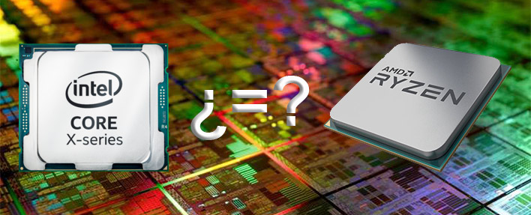
THE END

